Slide 1
NATIONAL INSTITUTE OF TECHNOLOGY SRINAGAR
Statistical Analysis and
Machine Learning-Based Prediction of Wine Quality
Physicochemical properties • statistical inference • sampling • regression and neural networks
ORIGINAL DATA
CLEANED DATA
STATISTICAL FOCUS
ML TASK
1,599 rows
11 predictors + quality
1,359 unique rows
240 duplicate rows removed
Alcohol mean, CI,
hypothesis tests, sampling
Predict numerical quality
Regression problem
Research question: To what extent can the physicochemical properties of red wine explain variations in quality scores, and how accurately can machine learning models predict these scores?
NIT Srinagar | Data Analytics Project | Red Wine Quality
1 / 6

Slide 2
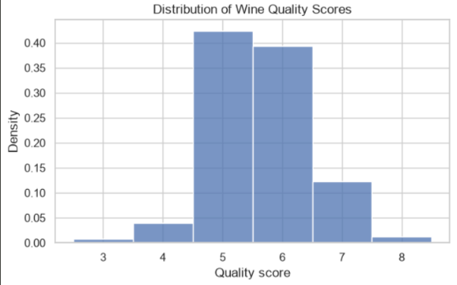
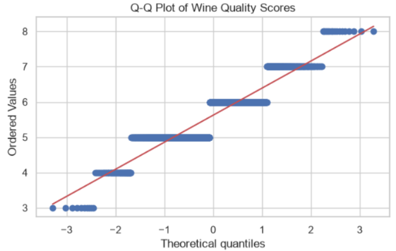
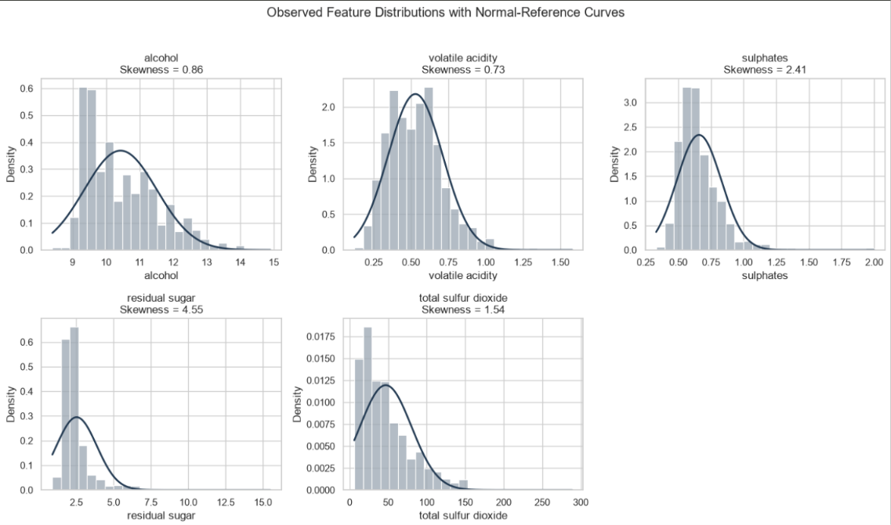
01 | DATASET AND DATA QUALITY
What does the dataset look like?
UCI Red Wine Quality • 1,599 original rows • 1,359 rows after exact-duplicate removal
DATA TYPES
ROWS
11 numerical physicochemical predictors; quality is a discrete numerical score.
1,599
original
PREPROCESSING
COLUMNS
12
No missing values. Removed 240 exact duplicate rows; duplicates were not automatically assumed to be errors.
11 features + target
INTERPRETATION
MISSING VALUES
Quality scores cluster around 5–6; rare scores are less represented. This is a discrete target distribution, not proof of normality.
0
no imputation
DUPLICATES
240
exact duplicate rows
NIT Srinagar | Data Analytics Project | Red Wine Quality
2 / 6

Slide 3
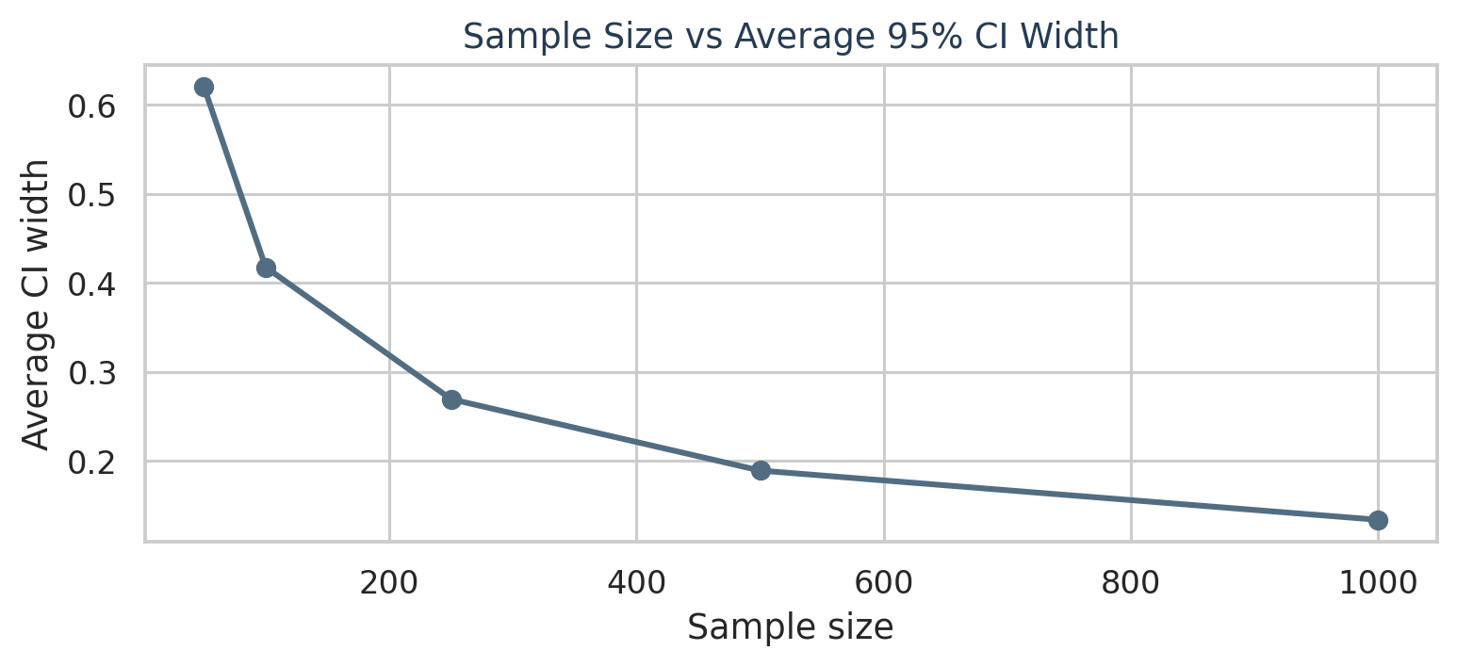
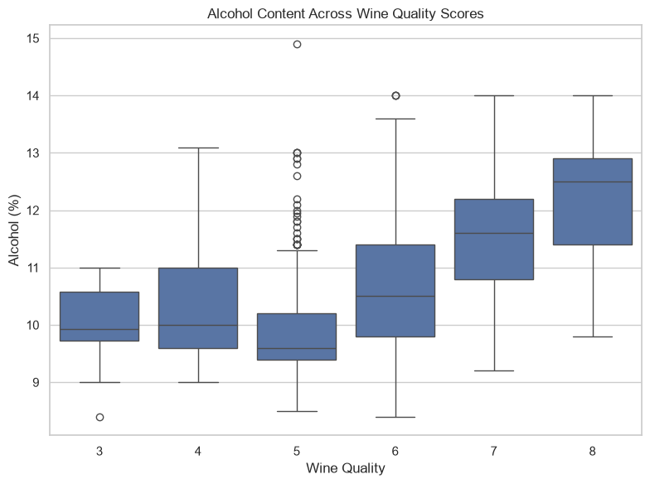
02 | STATISTICAL INFERENCE AND SAMPLING
Alcohol, hypothesis tests and sample-size effects
The notebook's observed results are shown below; statistical significance does not imply causation.
ALCOHOL MEAN
10.4323%
95% CI: 10.3747%–10.4899%
ONE-SAMPLE TEST
H₀: μ = 10%
t = 14.7284;
p ≈ 1.16 × 10⁻⁴⁵
Decision at α = 0.05: reject H₀
GROUP COMPARISON
Mean alcohol: quality ≤5 = 9.9208%; quality ≥6 = 10.8876%.
Welch test: p ≈ 1.80 × 10⁻⁶⁹
Decision at α = 0.05: reject H₀
SAMPLING AND CLT
Repeated samples fluctuate around the cleaned-data mean. As n increases, the standard error and average CI width generally shrink. CLT describes the sampling distribution of the mean—not the original feature distribution.
CORRELATION
r = 0.4803
Sampling method: SRS is a baseline; stratification by quality can preserve rare-score representation. For population estimates, account for stratum proportions.
alcohol vs quality
3 / 6

Slide 4
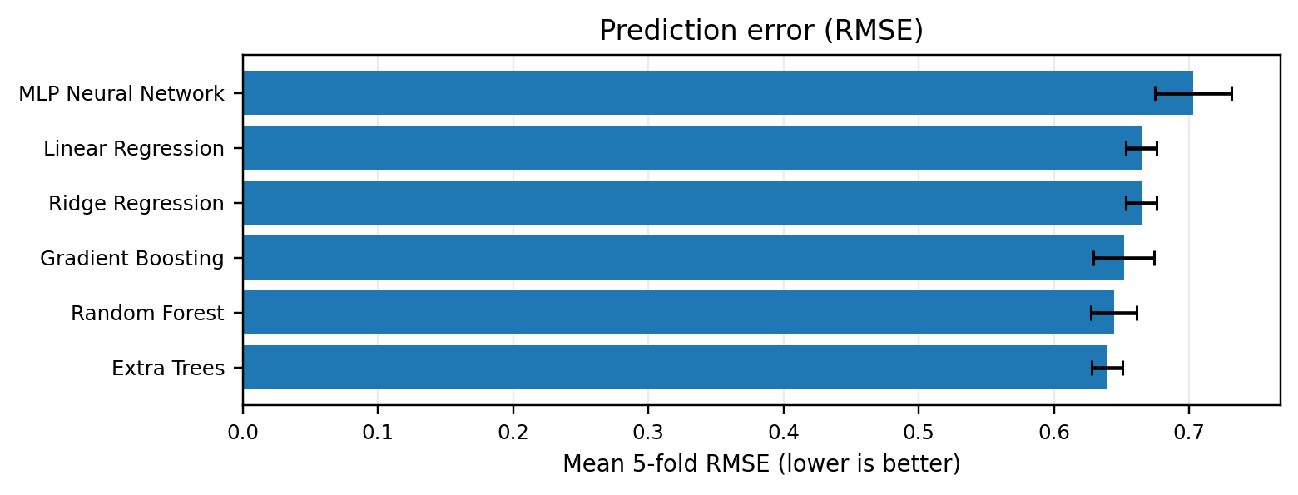
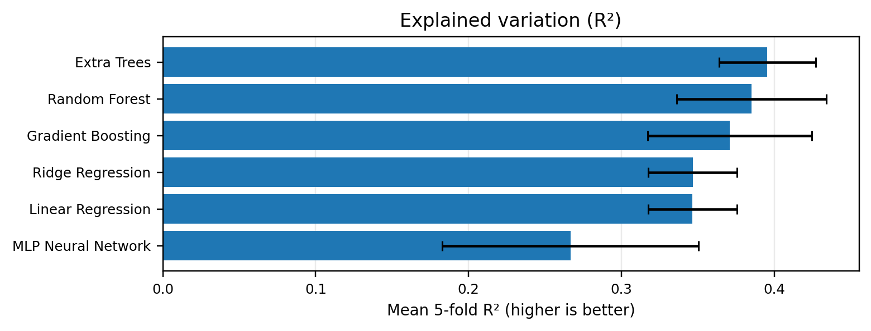
03 | MACHINE LEARNING
Six-model regression comparison
Five-fold shuffled cross-validation • same splits for all models
Model | MAE ↓ | RMSE ↓ | R² ↑
Extra Trees | 0.4837 ± 0.0120 | 0.6391 ± 0.0115 | 0.3954 ± 0.0317
Random Forest | 0.4930 ± 0.0162 | 0.6442 ± 0.0170 | 0.3850 ± 0.0488
Gradient Boosting | 0.5048 ± 0.0192 | 0.6515 ± 0.0225 | 0.3709 ± 0.0537
Ridge Regression | 0.5118 ± 0.0163 | 0.6645 ± 0.0113 | 0.3466 ± 0.0291
Linear Regression | 0.5118 ± 0.0163 | 0.6645 ± 0.0113 | 0.3465 ± 0.0291
MLP Neural Network | 0.5356 ± 0.0127 | 0.7028 ± 0.0281 | 0.2666 ± 0.0839
Finding: Extra Trees performs best on all three mean metrics (MAE 0.4837, RMSE 0.6391, R² 0.3954). Error bars show fold-to-fold SD; R² = 0.3954 is not 39.54% accuracy.
NIT Srinagar | Data Analytics Project | Red Wine Quality
4 / 6

Slide 5
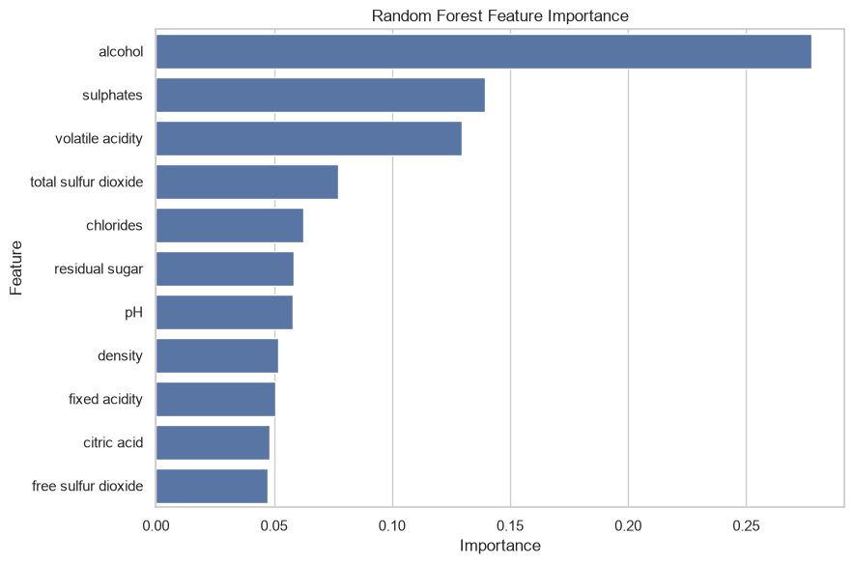
04 | INTERPRETATION AND MODEL EXTENSION
What matters, what remains uncertain
Feature importance is predictive association, not a causal explanation.
CURRENT FINDING
Extra Trees achieved the strongest mean cross-validation results among six models: MAE 0.4837, RMSE 0.6391 and R² 0.3954.
LIMITATIONS
R² ≈ 0.395 means substantial variation remains unexplained. The data are observational, and duplicate removal changes dataset weighting.
MODEL COMPARISON
Six models were evaluated on the same 5-fold splits. Extra Trees ranked first on MAE, RMSE and R²; MLP performed worst in this baseline setup.
NIT Srinagar | Data Analytics Project | Red Wine Quality
5 / 6

Slide 6
05 | CONCLUSION AND REFERENCES
Key conclusions
A compact summary of the evidence currently available in the notebook.
STATISTICS
SAMPLING
The cleaned-data mean alcohol content is 10.4323%; its 95% CI is 10.3747%–10.4899%. The mean differs statistically from 10% at α = 0.05.
Across 30 repetitions, larger sample sizes produced narrower average confidence intervals and more stable sample means.
MACHINE LEARNING
Extra Trees performed best among six tested models in five-fold cross-validation (RMSE = 0.6391, R² = 0.3954), but substantial variation remains unexplained.
References
1. UCI Machine Learning Repository. Wine Quality Dataset. https://archive.ics.uci.edu/dataset/186/wine+quality
2. Khan et al. (2025), “Improved machine learning framework with feature engineering and SHAP analysis for predicting wine quality,” Discover Applied Sciences (verify bibliographic details before submission).
NIT Srinagar | Data Analytics Project | Red Wine Quality
6 / 6

